Slide 1
Urban Sound Classification
A comparison of MLP, RNN, and CNN

Slide 2
Problem
Classification of sounds encountered in an urban environment like running ACs, idling cars and gunshots.
Approaches taken:
Multilayer Perceptron
Recurrent Neural Network
Convolutional Neural Network

Slide 3
Dataset
UrbanSound8K
Classes = {air_conditioner, car_horn, children_playing, dog_bark, drilling, engine_idling, gun_shot, jackhammer, siren, street_music}
Folds = 10
Format = .WAV
File Count = 8732

Slide 4
Preprocessing
WAV files need to be preprocessed for feature extraction.
Load WAV to time series
Features = {MFCC, Tonnetz, Mel-Scaled Spectrogram, Chromagram, Spectral Contrast}
Implemented using librosa
Train/Test split
One-Hot

Slide 5
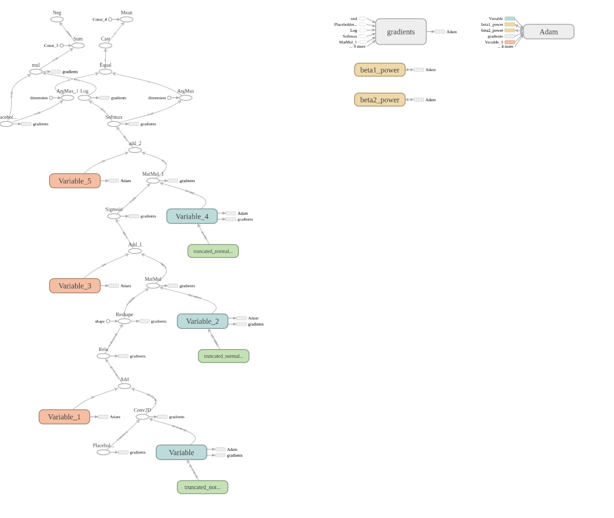
Architecture (CNN)

Slide 6
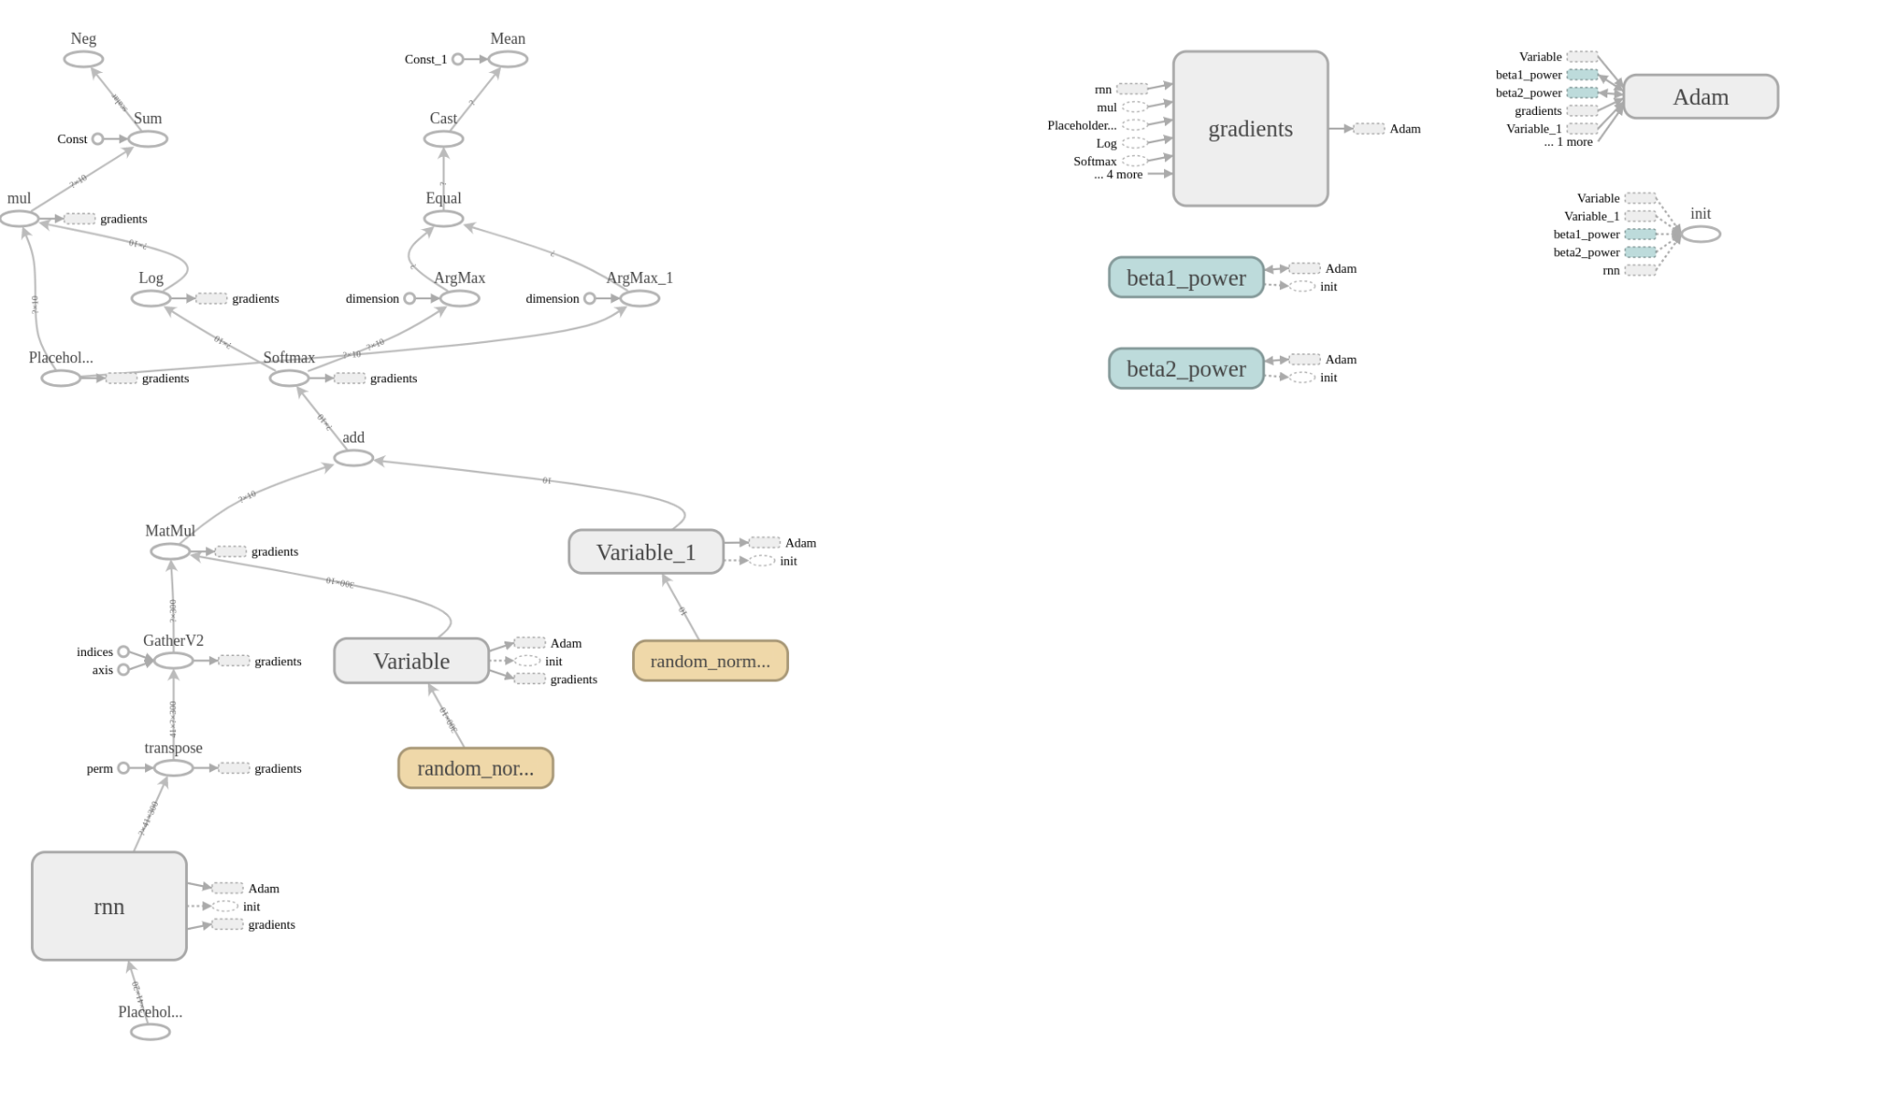
Architecture (RNN)

Slide 7
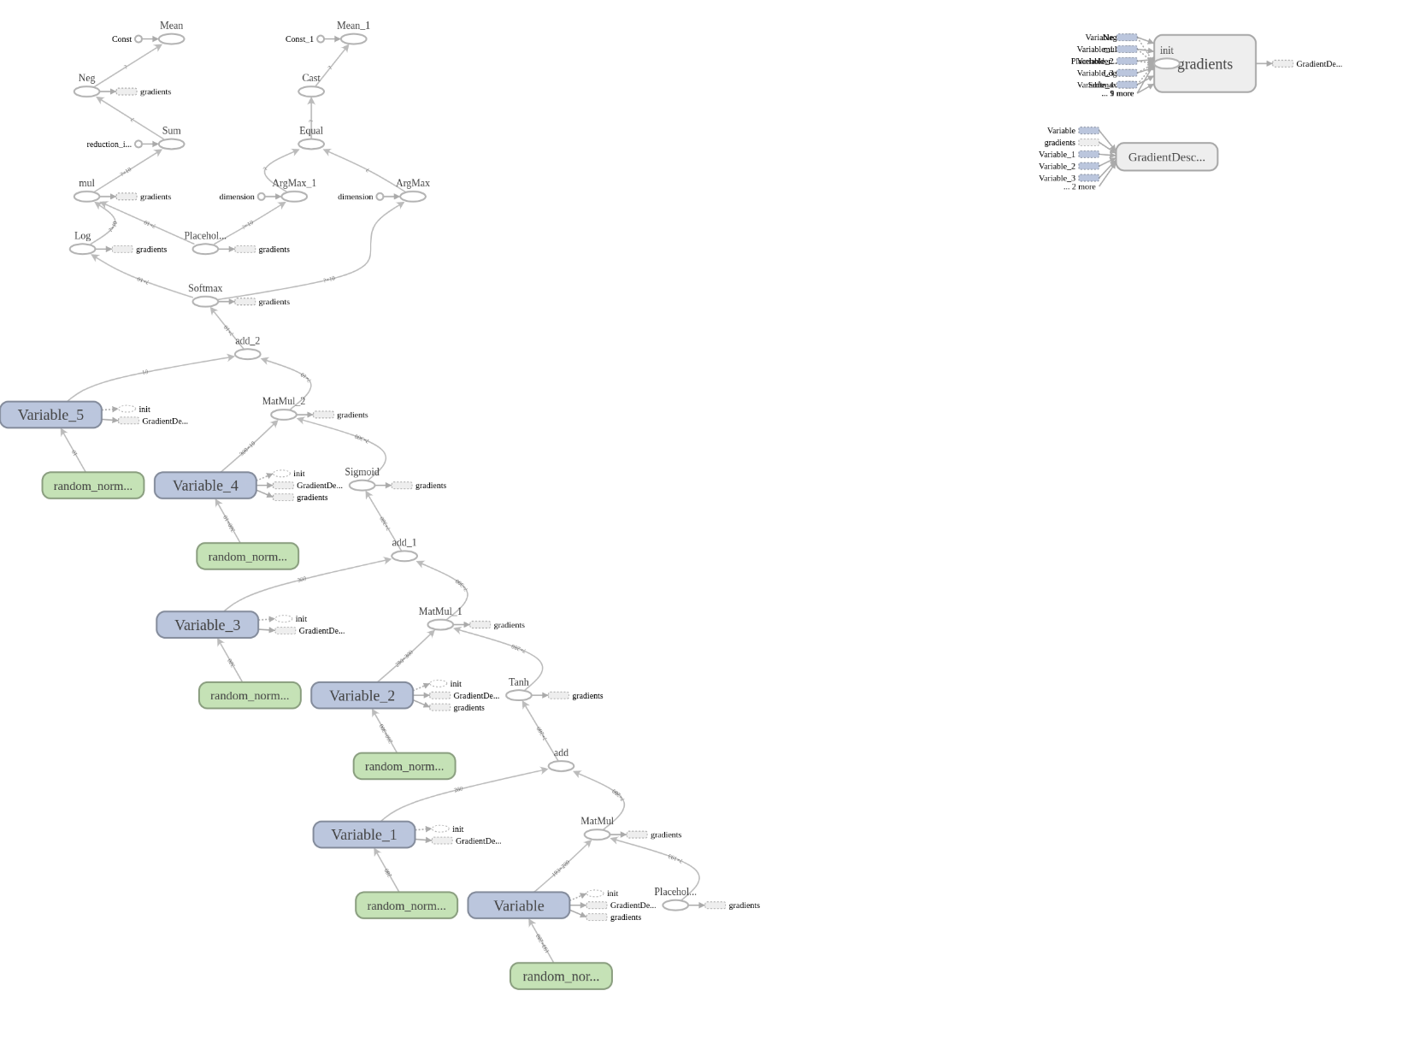
Architecture (MLP)
Notes:
Loss, Optimizer

Slide 8
Results (CNN)

Slide 9
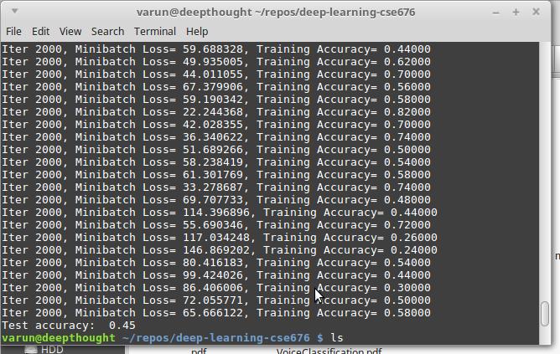
Results (RNN)

Slide 10
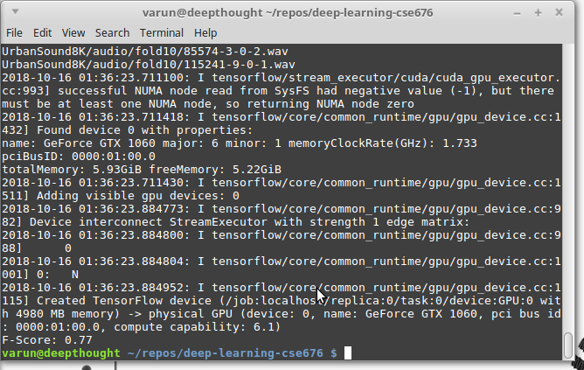
Results (MLP)

